Slide 1
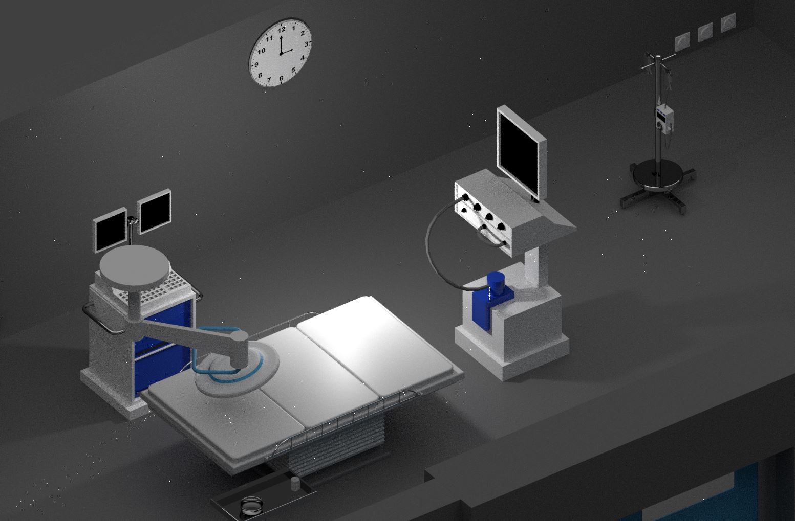
The Virtual Surgery Room
Studente/i
Relatore
Correlatore
Committente
Jonathan De Boni
Puiatti Alessandro
Paoliello Marco
Puiatti Alessandro
Corso di laurea
N° Progetto
Anno
Data
Ingegneria Informatica (TP)
C10094
2018/2019
30 Agosto 2019
Abstract
The technology of Virtual Reality allows to obtain excellent results in the field of play, safety and education at a very low cost. These particular properties are included in this project giving the user the opportunity to learn the procedures for operating in an operating room.
Each user can interact with every single object in the scene, having fun and learning in total safety. The integration of the missions also leads to personalizing one's own path, giving the opportunity to have various scenarios to train on.
The following document provides a detailed explanation of the path taken during the project also giving a motivation to the stylistic and architectural choices. The required result was satisfied by adding typical interactions of reality to allow a realistic and better experience within the simulation.
Targets
With this project we want to develop a simulator in virtual reality using a 3D viewer (Htc Vive) that reproduces the operating block of a hospital with the different rooms: the patient preparation room and the operating room itself. The purpose is to train nurses on the procedures to be followed during the reception of the patient up to the displacement of the same in the operating room.
Each room must contain its own specific equipment with which the user can interact within the virtual environment. Each item of interest must be provided with a legend and any usage information.
The simulation will have to keep track of the operations carried out by the nurse to monitor the correct execution and performance.
The project requires having successfully followed the computer graphics and virtual reality courses.
Conclusion
This project provided the bases on which to develop further functionalities through virtual reality in teaching practice, giving the opportunity even to the less experienced people to use this software.
Among the interesting features of the program of the system based on virtual reality as a teaching tool we find complete ease of use, a safe place to learn and its versatility. Another interesting feature is the fact that you can use the system anywhere, at home with your PC, with your phone (Cardboard) or in a small room with your HTC Vive device. The power of this technology also allows for complete personalization of the scene, giving hospitals the opportunity to simulate their operating room by integrating it into the system in a simple way.
Another interesting quality of the project is purely economic and practical, given that currently hospitals have the need to save on infrastructure and available space and therefore simulation with various technologies is useful, such as the technology used in this context that needs few resources and a moderate cost.
After analyzing the final result myself I can say that the system has the ability to teach a lot, accurately and fun.

